Slide 1
VISUAL C#.NET session two
Instructor: Edwin oduor

Slide 2

Quote of the day

Slide 3
Lesson objectives
Variables and Data Types
Getting to Understand and know different Data types
Rules for Naming Variables
Message Box

Slide 4
Lesson pre-requisites
In order to take full advantage of this section you need to have the following;
Computer with Visual Studio Installed.
Stable Network Connection.

Slide 5
Training methods and extra readings
TRAINING METHODS FOR THIS LESSON
EXTRA READINGS
Lecturing Method – This is the main method of training to be adopted in this lesson with illustrations and practical coding examples.
Discussion Method - This method will be adopted periodically whereby learning will be derived principally from the students brainstorming together, rather than from the trainer. Three main types of discussions will be used:
Directed discussion
Developmental discussion
Problem-Solving discussion
Home and Learn C#

Slide 6
Variables & data types

Slide 7
What is are variables & data types

Slide 8
Variable is a storage location or a storage area, for holding things that you will need later, therefore to reserve some space in the computer memory then a variable is used. If a simple calculation is to be done then three variables are going to be created, one for holding the value of the first number, second one holding value of the second number and the third one for holding the answer.
Datatypes is the kind of information that is going to be stored in the space reserved. For instance in the code below, a variable of integer data type has been created, the name of the variable is num1 and the variable has been assigned value 10.
int num1 = 10
Name of variable
Datatype
Name of variable

Slide 9
There are many different data types namely
Integer – this holds whole numeric values
String – holds text values i.e., name of a city, name of a person etc.
Boolean –Yes/No, true/ false
Float – holds decimal values 7digit precision
Decimal - holds decimal values 15digit precision
Double - holds decimal values 28digit precision
There quite a number of datatypes this is just to mention a few. For more datatypes visit this site https://www.javatpoint.com/csharp-data-types.

Slide 10
Rules for naming variables
One word no space, use of underscore if you want to give space
Should not be key words
Should not start with a numeric number when naming variable

Slide 11
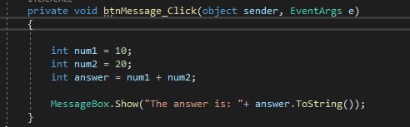
Understanding more about variables
To understand more about variables and datatypes lets create three variables of integer datatypes, the first two variables will use to assign the values while the third variable will be used to hold the answer, then display the answer on a message box.

Slide 12
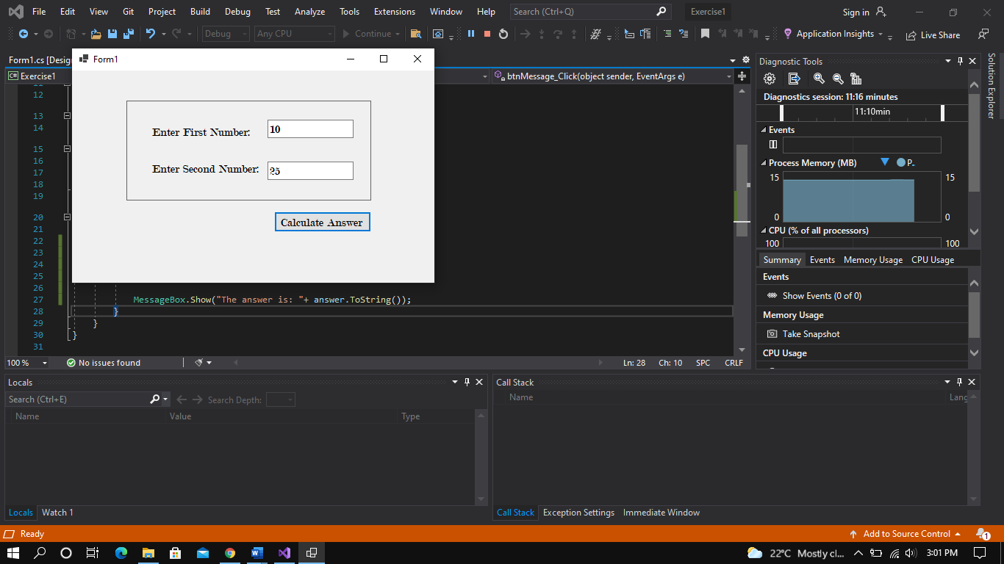
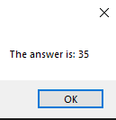
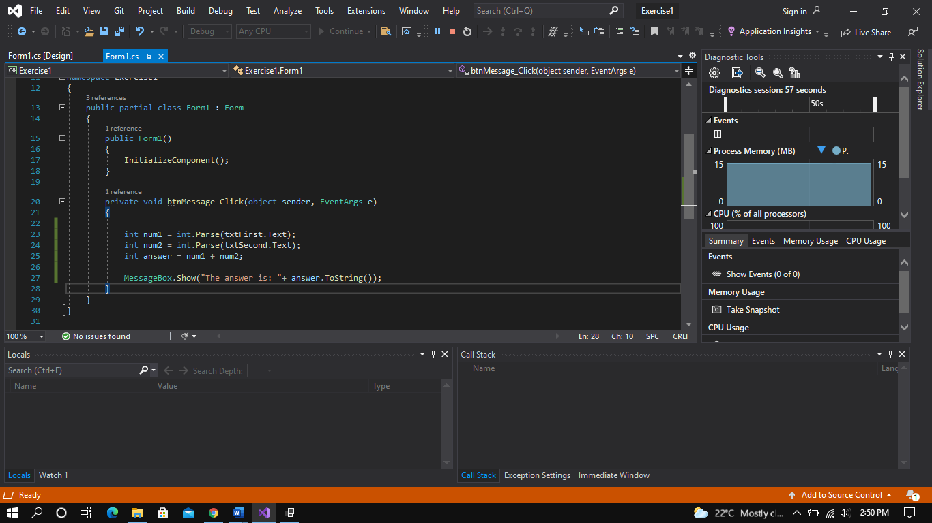
Contd.. on variables
To do the same Exercise but this time round we won’t hard code the values rather we will get the values from the user by typing in the values in the text box.

Slide 13
Message box

Slide 14
What is a message box

Slide 15
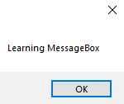
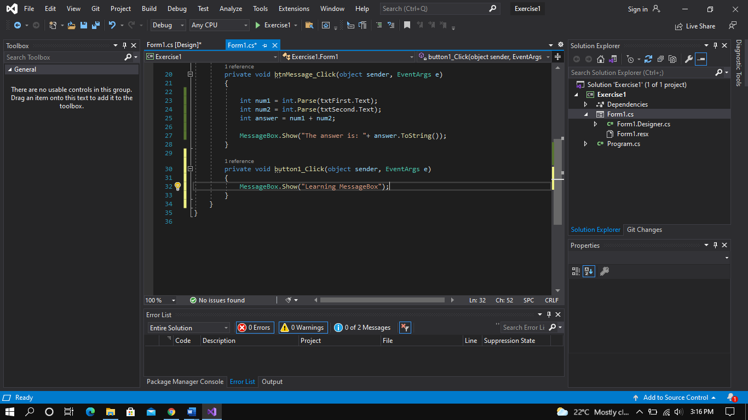
A message Box is a way of communicating with the user when an action has been performed. Therefore a message box keeps the user informed for instance when they click on a button.
Given the code below… will give the output on the right.

Slide 16
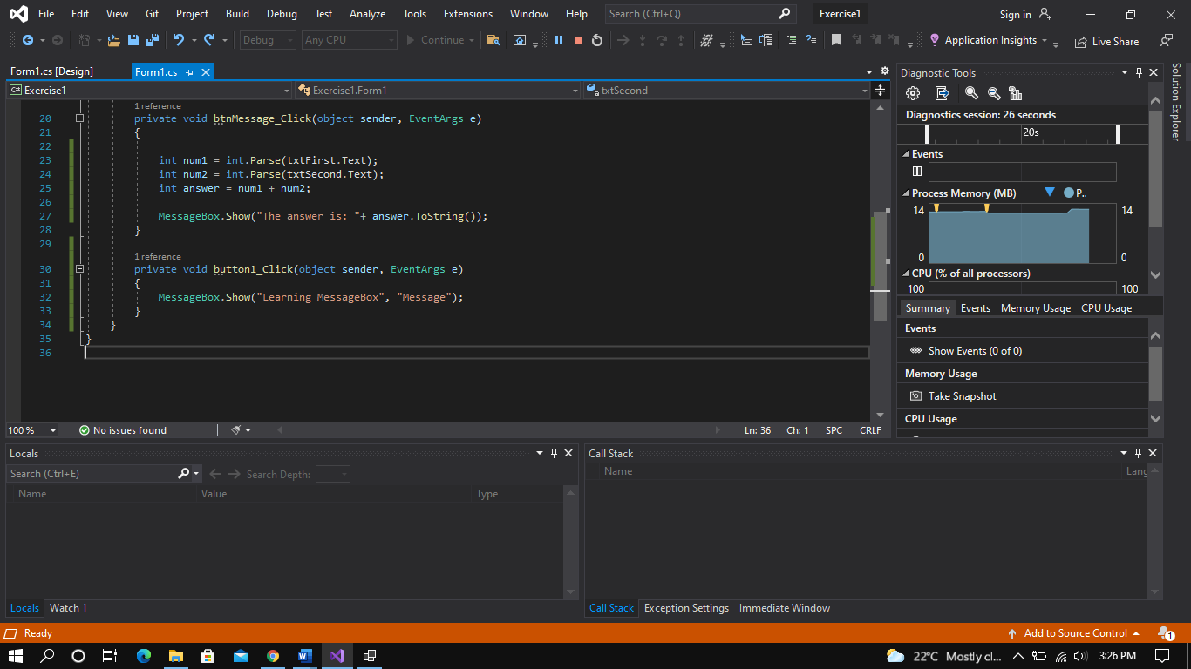
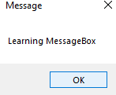
Below code will produce, the message below.

Slide 17
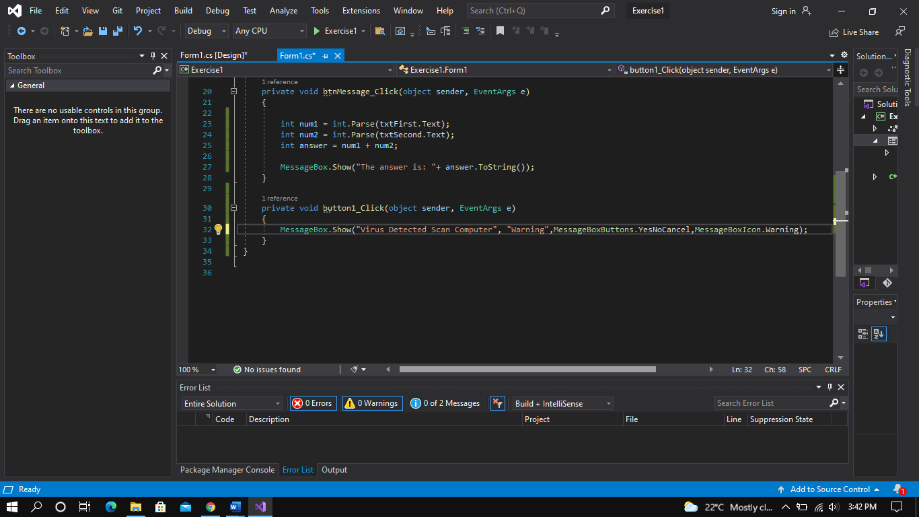
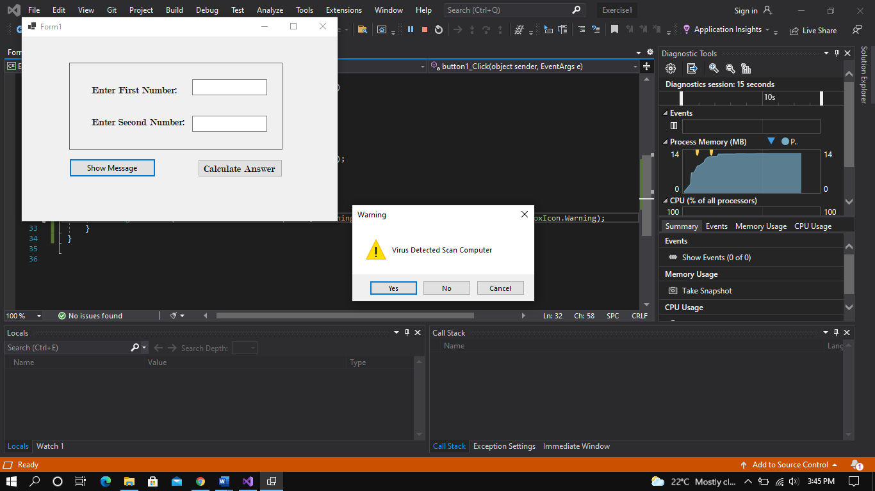
Below code will produce, the message below.

